Slide 1

International Debt Statistics Analysis

Slide 2

TEAM 20------YAMINI &TEJASRI
PHOTOS

Slide 3

AGENDA
Welcome and Introduction
Project Purpose and Data Used
Unique Aspects of Our ERD
Highlights of Key Reports
Live Demo of Selected Reports
Final Thoughts and Recommendations

Slide 4
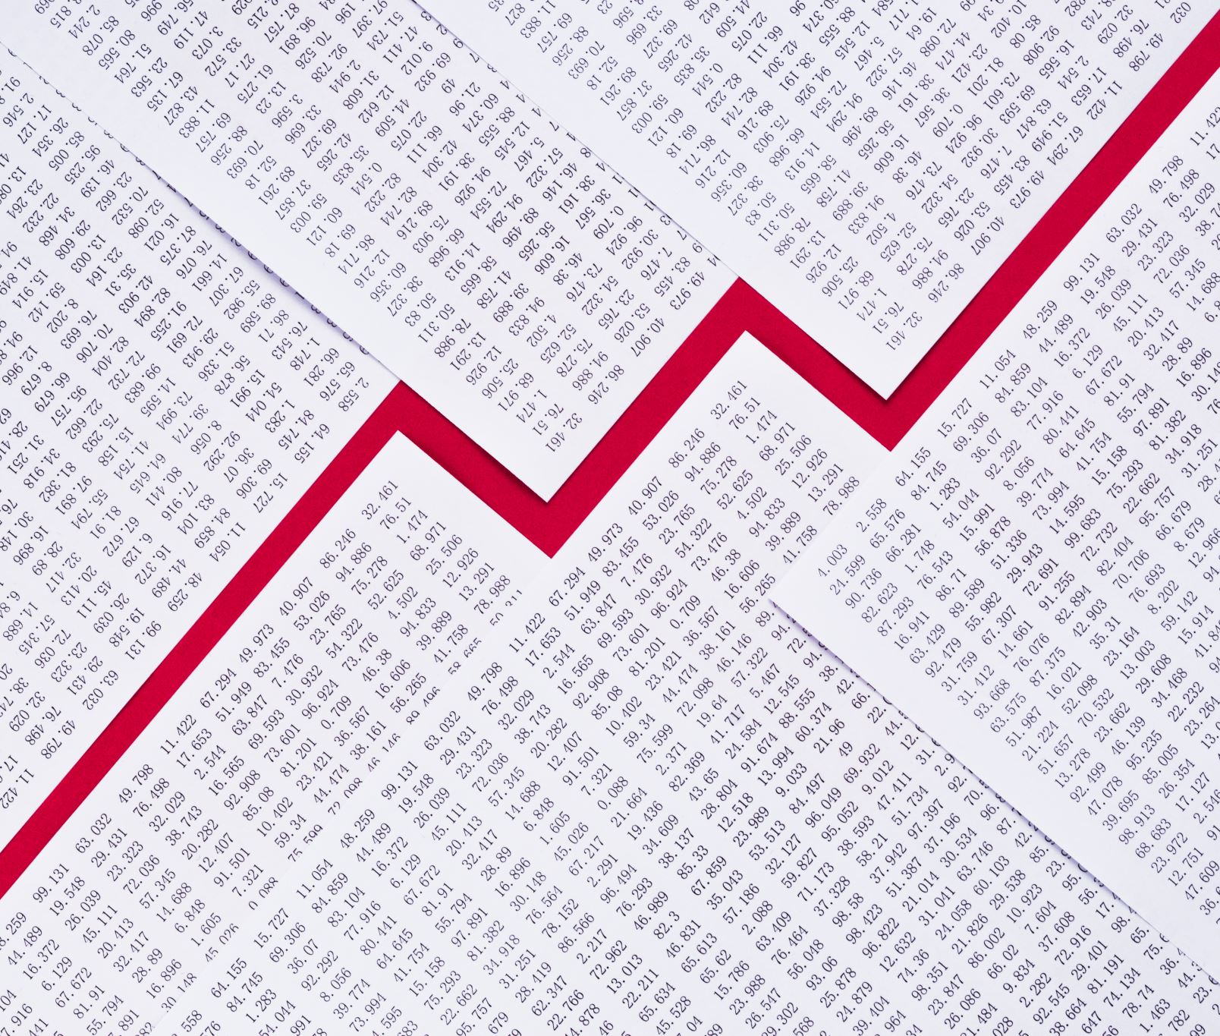
PROBLEM
Goal: We're looking into global debt to see how it affects countries' finances and to spot patterns in how they pay it back.
Questions: We want to find out which countries are paying off their debts the most, how they manage their debt over time, and the common kinds of debt deals they're making.
Data Used: Our study is based on international debt data, focusing on records of debt issuance, repayments, and agreements. We've put this information together in an easy-to-understand diagram that helps us analyze the data effectively.

Slide 5
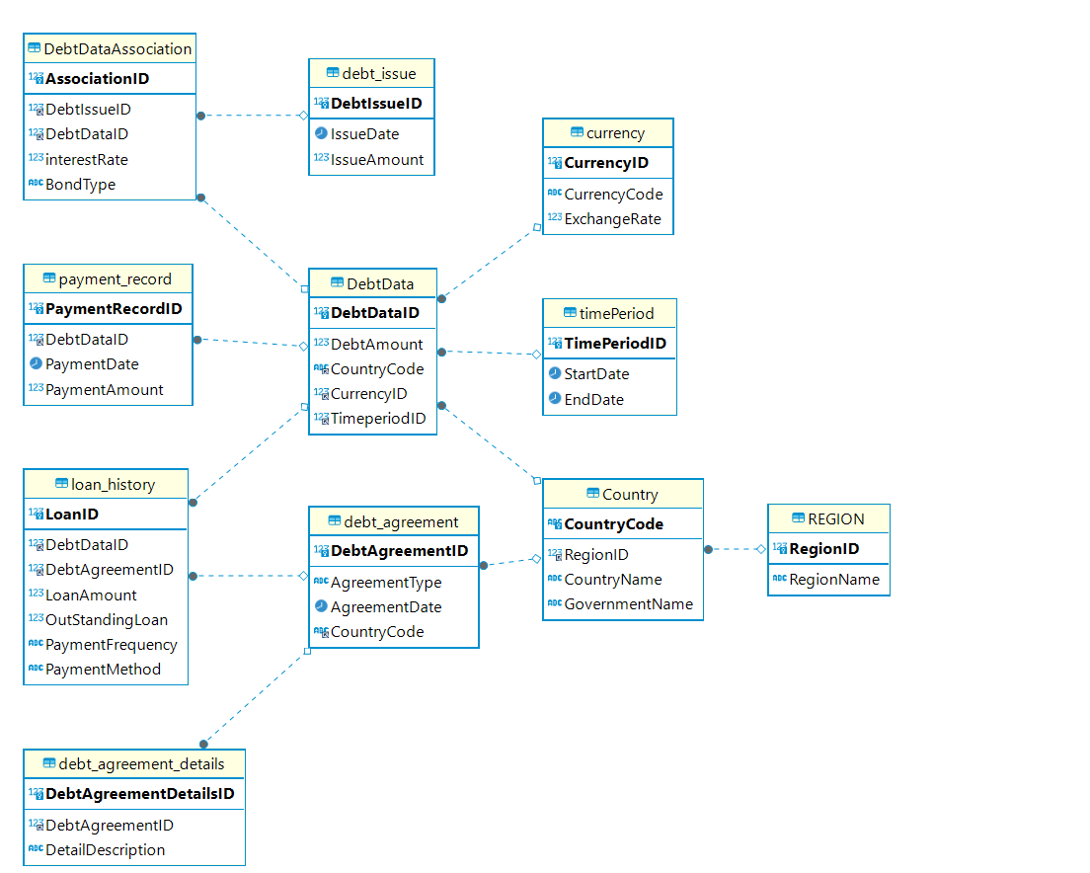
ERD

Slide 6
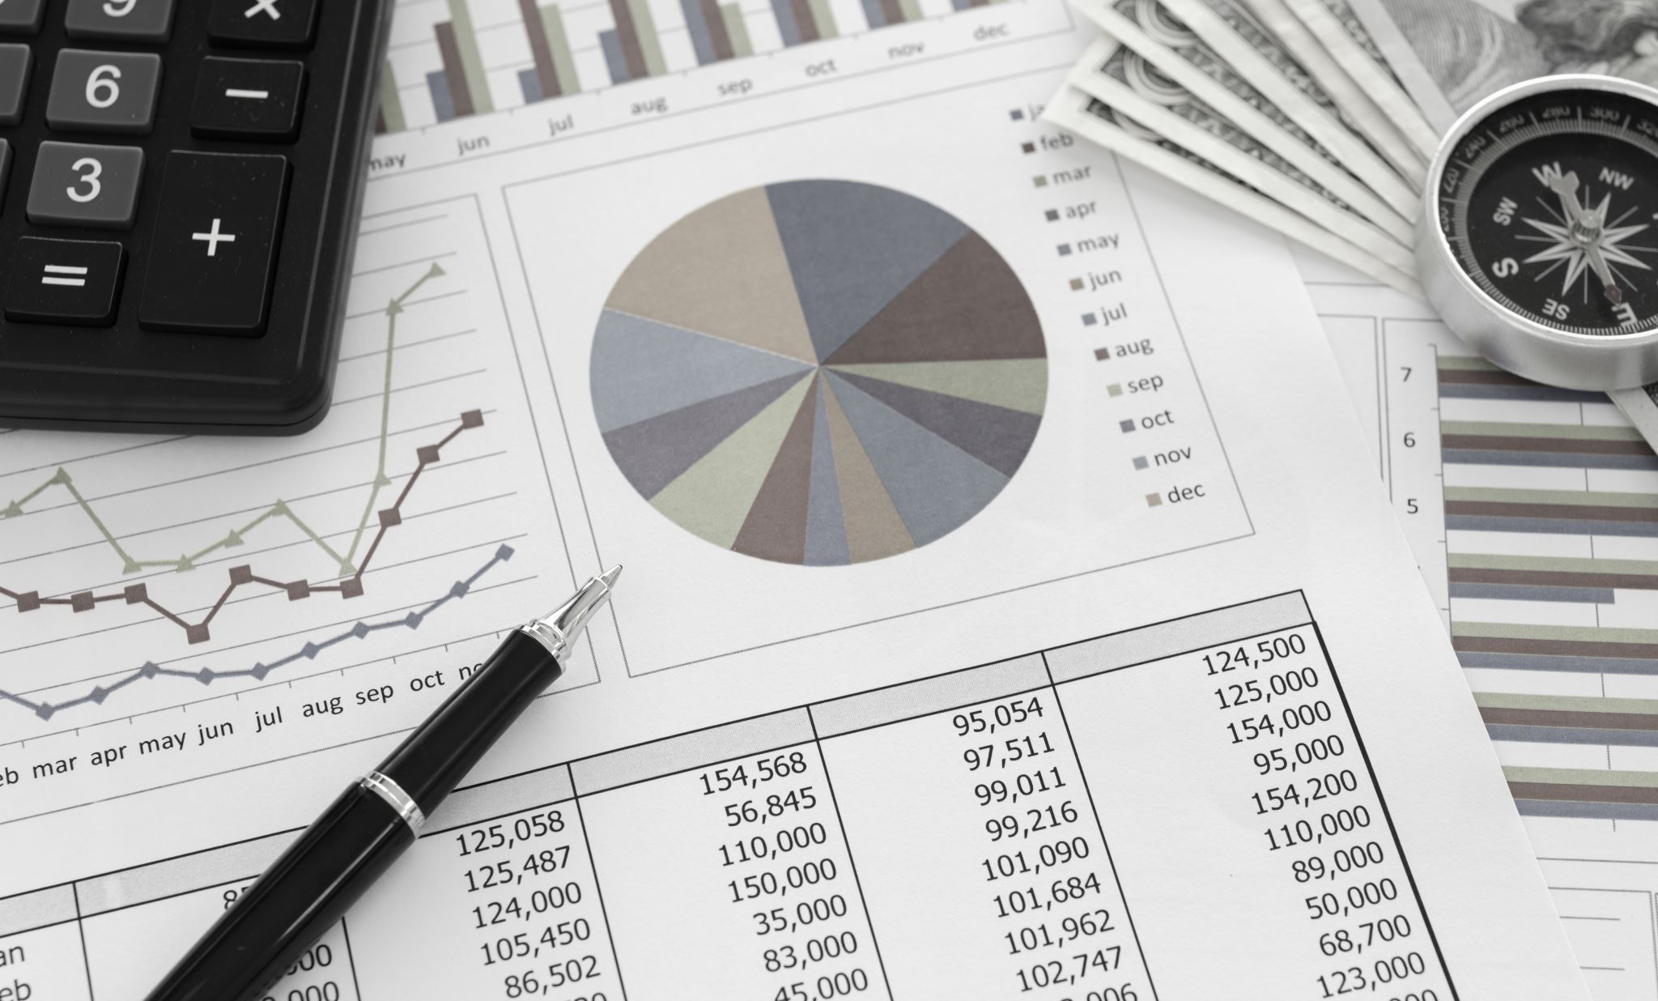
Reports Overview

Slide 7
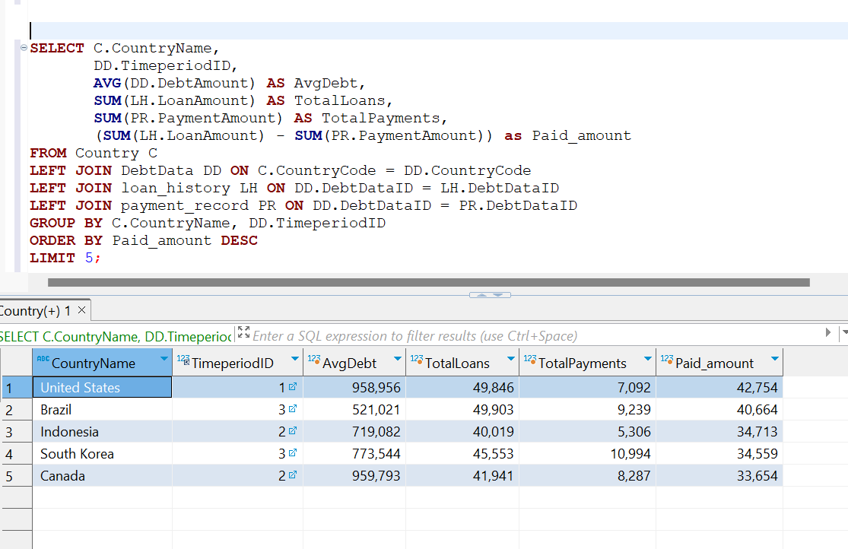
Report 1: Top five countries which paid the debt amount
The report highlights countries with the best debt repayment records, allowing us to offer targeted financial advice and help them fine-tune their debt strategies.
By understanding these countries' financial behaviors, we can create specialized training for government officials to bolster their financial management, benefiting their long-term economic health and our business relationships.

Slide 8
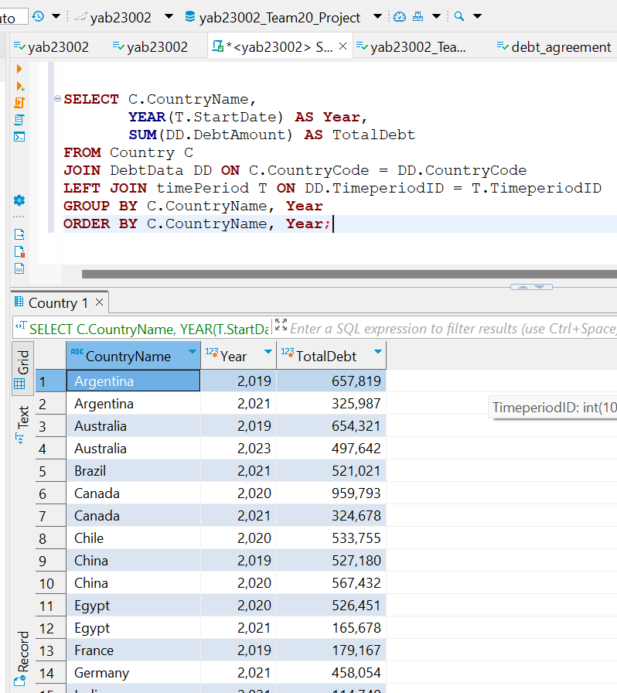
Report 2: Debt Data Analysis with Yearly Aggregation
The report's insights into countries' debts could be used to advise them on cutting down debt through better financial planning and negotiations.
We could create a tool that combines various debts of a country into one, making it easier to manage and pay off.

Slide 9
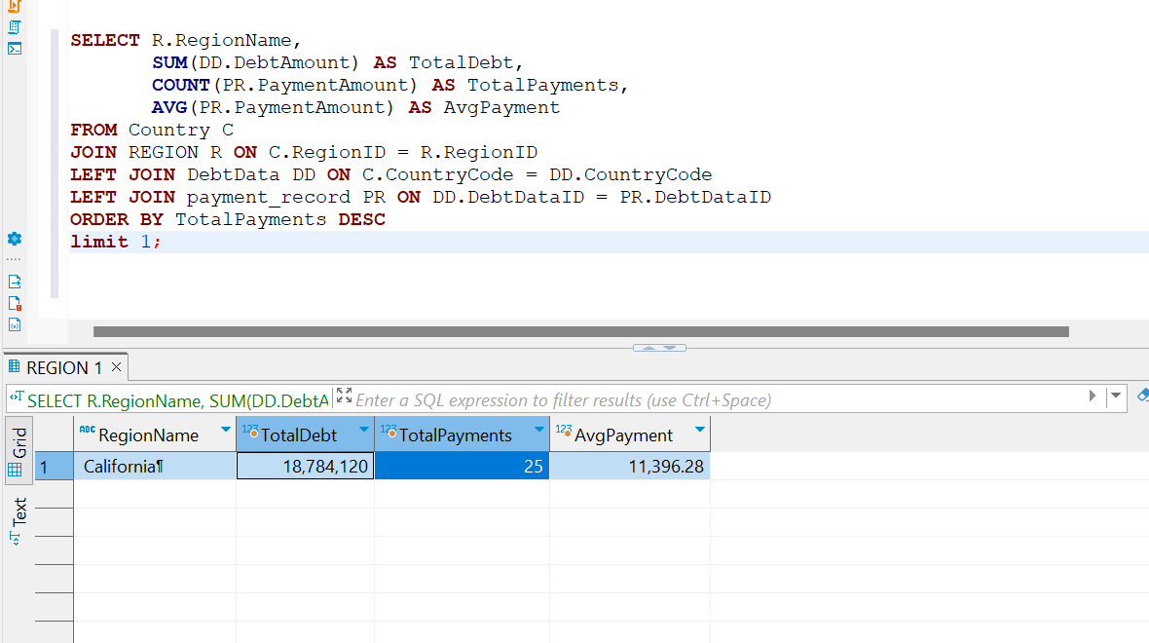
Report 3: Region with the highest number of payments
Use the report to launch a service that ranks regional financial performance, encouraging countries to improve their debt management.
Establish a fund to back sustainable growth projects in high-debt-repayment regions, paired with consultancy for financial risk management.

Slide 10
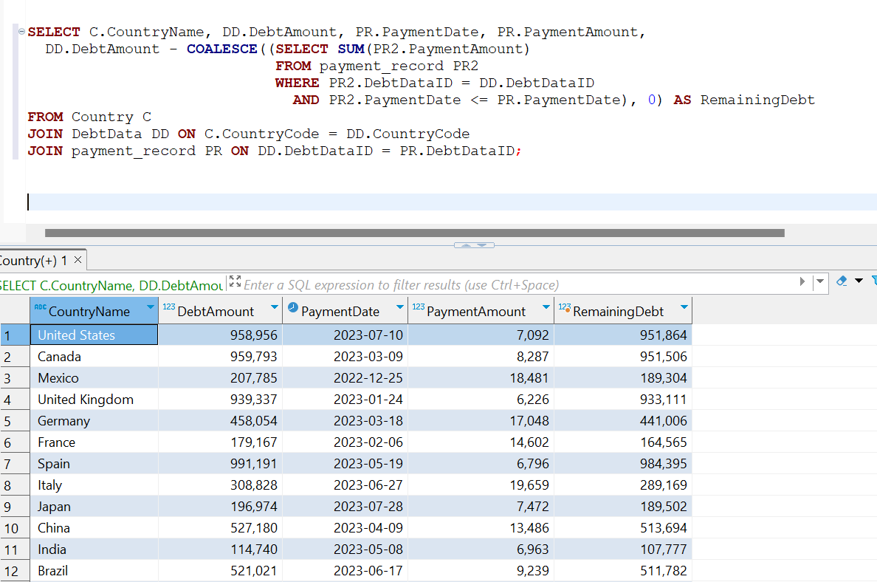
Report 4: Debt Service Cost Analysis
Offer consultancy to help countries plan and reduce their debt payments over time using real-time debt tracking.
Develop software that lets countries see how different repayment strategies affect their remaining debt, aiding in better financial decision-making.

Slide 11
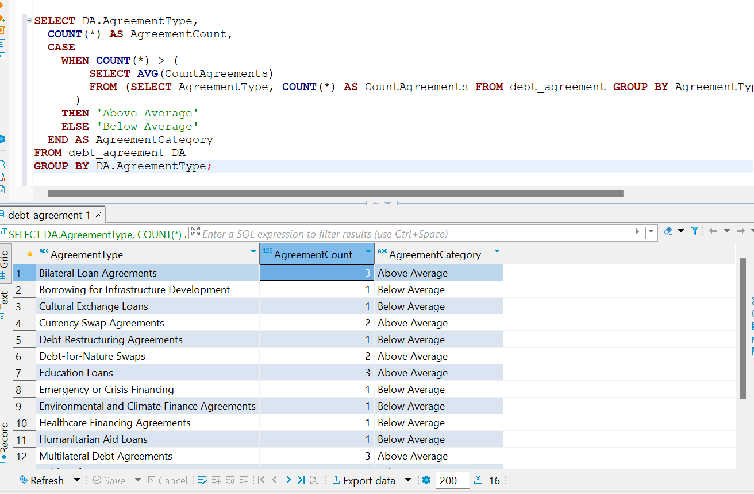
Report 5: Debt Agreement Type Analysis
Create a platform that simplifies the management of debt agreements, comparing them with industry averages and suggesting improvements.
Provide a tool that offers real-time simulations and adjustments to help organizations strategically align their debt agreements with financial objectives.

Slide 12

Challenges and Solutions:
Data Complexity: We navigated through complex international debt data, breaking it down into simpler segments for analysis. This was addressed by developing a clear ERD that helped us understand and manage the relationships between different data types.
Report Accuracy: Ensuring the accuracy of our reports was challenging due to the dynamic nature of international debt statistics. We implemented rigorous data validation checks and used real-time data processing to maintain high standards of accuracy.

Slide 13

Recommendations:
Automate Data Collection: For future projects, setting up an automated data collection process would save time and reduce errors, ensuring that the most current data is always used for analysis.
User-Friendly Dashboards: Develop interactive dashboards that allow users to customize and visualize data. This would make the findings more accessible and actionable for decision-makers.

Slide 14

QUESTIONS?

Slide 15

THANK YOU

